Slide 1
Programming Fundamentals
By
Shazmeen Batool

Slide 2
Lab Task 1
Write a function named displayGreeting that prints "Hello, World!" to the console. Call this function from main.

Slide 3
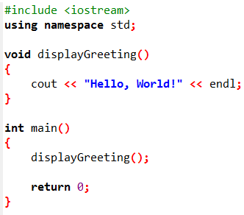


Slide 4
Lab Task 2
Create a function named addNumbers that takes two user entered integers as parameters, adds them, and prints the sum. Call this function from main.

Slide 5
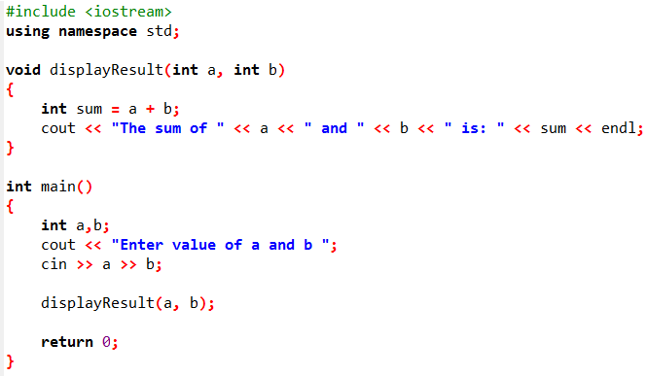


Slide 6
Lab Task 3
Create a function named printEvenOrOdd that takes an integer parameter and prints whether the number is "Even" or "Odd". Call this function with a user entered number.

Slide 7
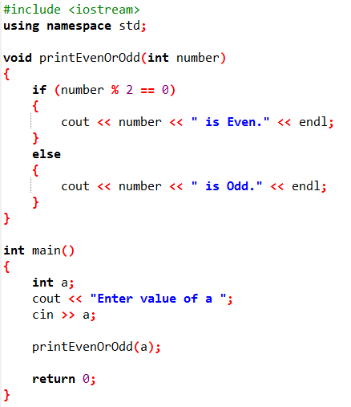


Slide 8
Lab Task 4
Define a function called printRectangle that takes user entered width and height as parameters and prints the rectangle shape made of * characters. Call this function with sample values.

Slide 9
